Slide 1
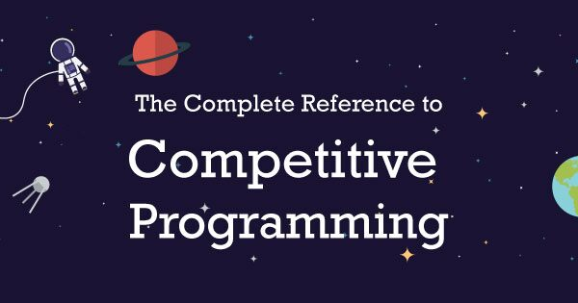
By – Siddhant saxena

Slide 2
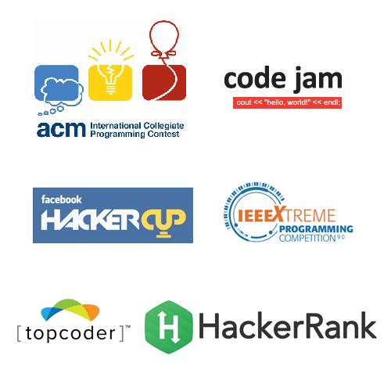
What is it?
■ Writing programs to solve problems in a contest environment.
■ One has a limited time to solve the problems. Ranging from a few hours to a few days.
■ The solution should be efficient in terms of execution time, memory used or in some cases even the length of code.

Slide 3
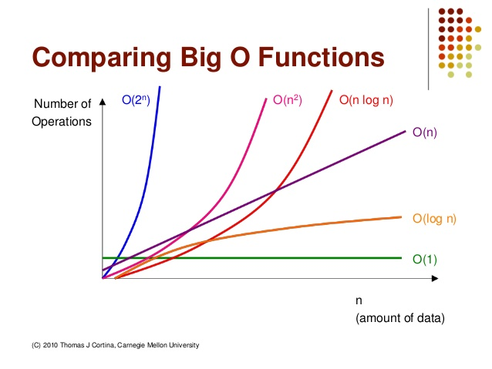
What’s new?
The code will be executed on an Online Judge (OJ).
■ Which means you should write code which conforms to the specific format of input and gives the output in the required format.
■ With tough constraints on execution time, it is crucial that you use faster algorithms to avoid TLE(s) on your test cases.
■ This requires a good knowledge of time complexities

Slide 4
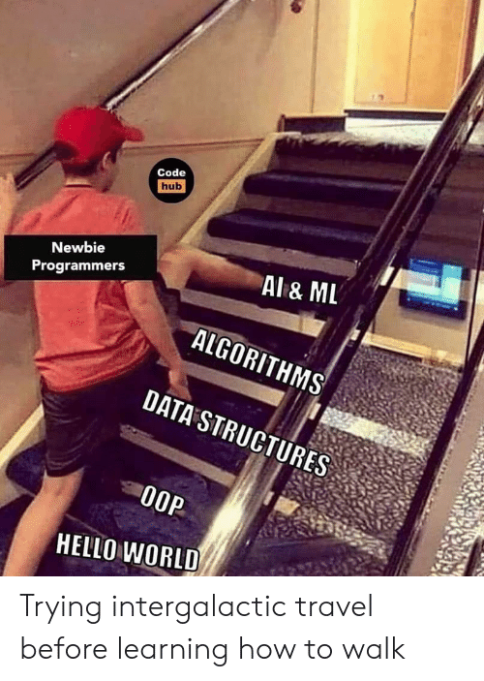
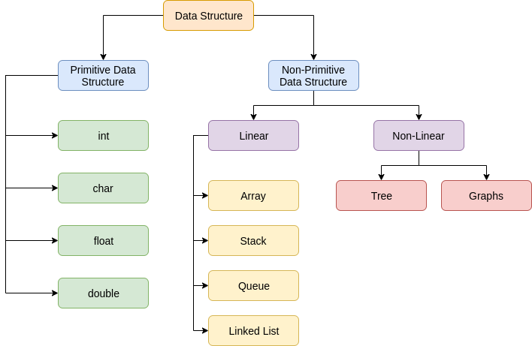
Intuition of Data Structures
Data Structure can be defined as the group of data elements which provides an efficient way of storing and organizing data in the computer so that it can be used efficiently. Some examples of Data Structures are arrays, Linked List, Stack, Queue, etc. Data Structures are widely used in almost every aspect of Computer Science i.e. Operating System, Compiler Design, Artificial intelligence, Graphics and many more.

Slide 5
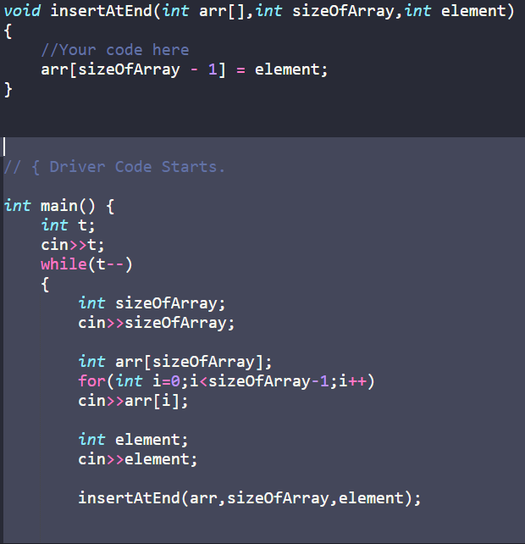
Understanding the input format
Input on OJ’s is very straightforward. You don’t need to prompt for it like we usually do.
The first line of input is usually the number of test cases, followed by the test cases.

Slide 6
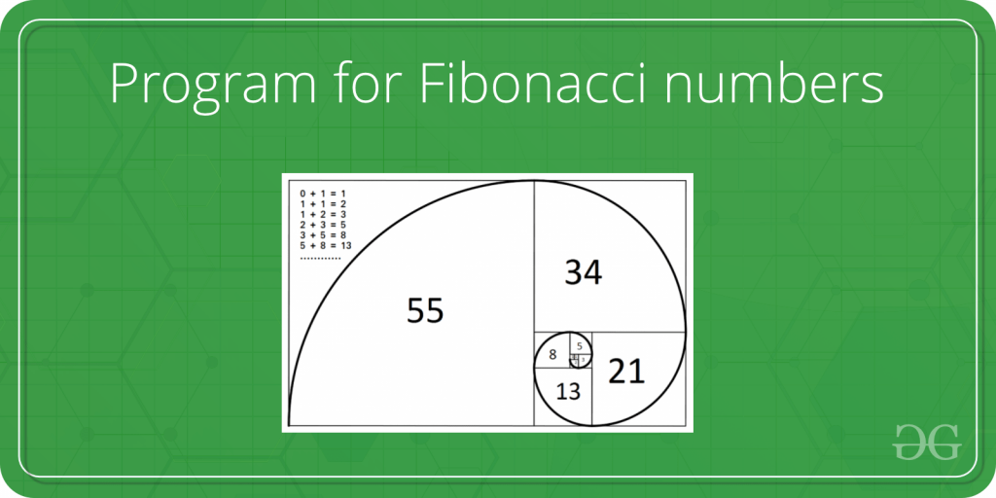
Program for Fibonacci numbers
Last Updated: 18-11-2020
The Fibonacci numbers are the numbers in the following integer sequence.
0, 1, 1, 2, 3, 5, 8, 13, 21, 34, 55, 89, 144, ……..
In mathematical terms, the sequence Fn of Fibonacci numbers is defined by the recurrence relation
Fn = Fn-1 + Fn-2
with seed values
F0 = 0 and F1 = 1.

Slide 7
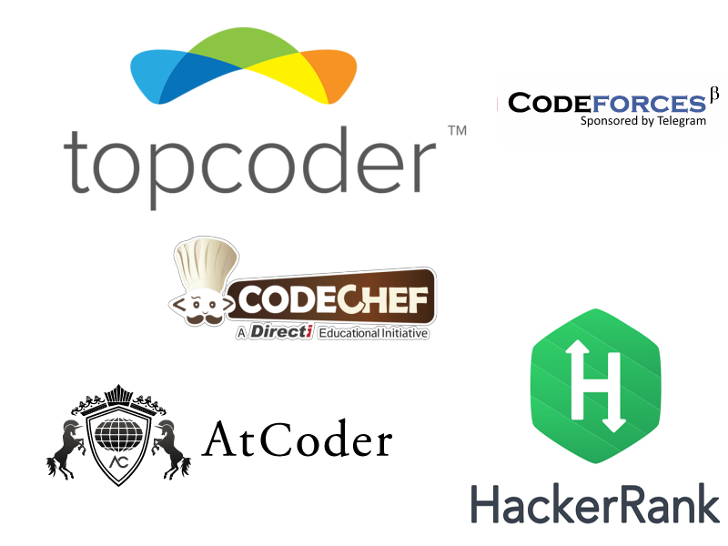
Getting started with competitive coding:
Solving the problems in a coding contest is not easy. Many online judges have problems of similar difficulty and similar environment. A list of such judges are:-
1. TopCoder
2. SPOJ
3. Codechef
4. HackerEarth
5. HackerRank
6. Codeforces
And many more…

Slide 8
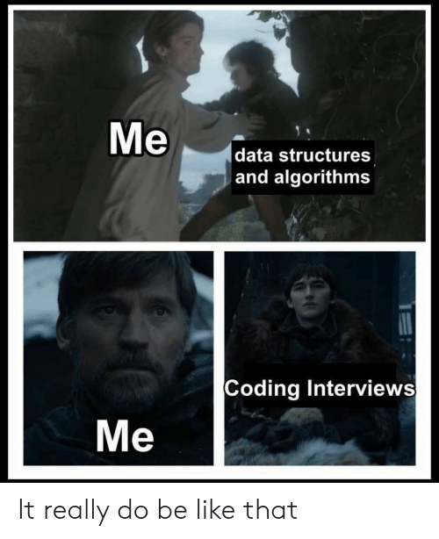
A few tips to perform better:
Have a thorough grasp on the basic concepts first.
Develop a good understanding of data structures like lists, trees and graphs.
Try to learn as many new and efficient algorithms and implement them when required.
CP Handbook :- https://cses.fi/book/book.pdf

Slide 9

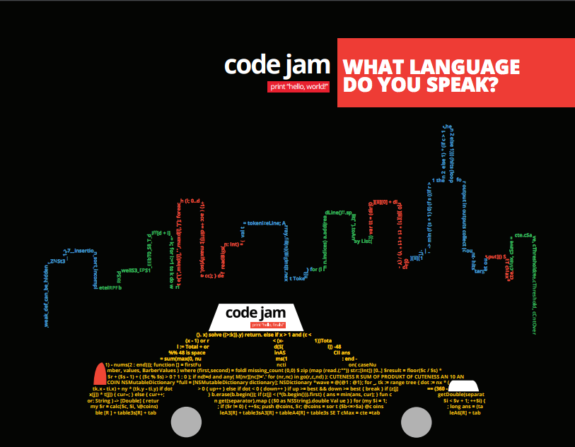
Some prestigious contests:
1. ACM – ICPC
2. Google Code Jam
3. Topcoder Open
4. Facebook Hacker Cup (Recent)
Students who perform well in these contests are some of the finest brains in the world and instantly recognized by top institutions (companies, academia).

Slide 10
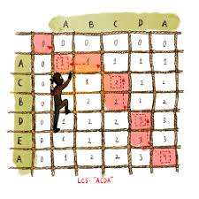
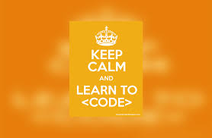
What’s next?
■ Sign up on any of the plethora of online judges and start solving their practice problems.
■ You will run into a lot of errors in the beginning.
■ Also, participate in other online contests arranged by sites like codechef and SPOJ.
■ Many companies use these contests to hire students for jobs and internships as well.

